Slide 1




A high-order non-aligned approach for plasma transport simulations in tokamaks
Giorgio Giorgiani, M2P2
Hugo Bufferand, Guido Ciraolo, Frederick Schwander, Philippe Ghendrih, Eric Serre, Patrick Tamain
Méthodes numériques pour les plasmas – Marseille, 23 novembre 2018
Notes:
Good afternoon and thank you for having me here today. I am going to present you this work entitled “A high-order non-aligned approach for plasma transport simulations in tokamaks”. This work is the product of a collaboration between the Aix-Marseille University and the CEA Cadarache, in particular the IRFM, and it has been founded by the Amidex foundation and also EoCoE project.

Slide 2
Outline
Motivation of the work
The HDG scheme in a nutshell
High-order and numerical diffusion
Numerical tests on real geometries/magnetic configurations
Notes:
Here is the outline of the presentation, I’ll start form the motivation of the work, then I ‘ll talk a little bit of the numerical scheme, which is called HDG, then I will focus on high-order, and finally I’ll show you an application on a real tokamak geometry.

Slide 3
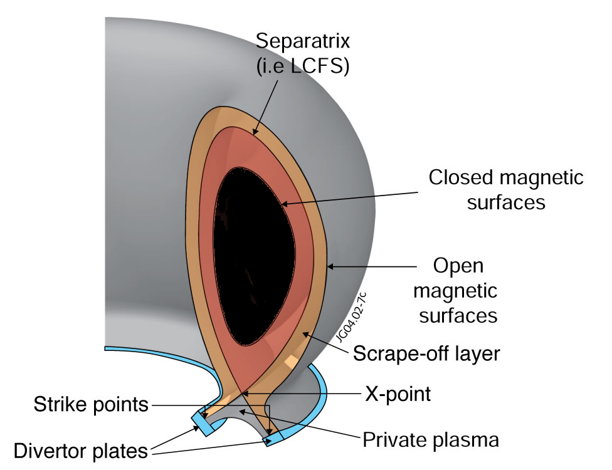
Motivation: plasma edge simulation
Main technological challenge
Control the heat flux at chamber walls
Plasma-edge modelling
To help the design of optimized operation scenarios (2D)
To better characterize the transport (3D)
In support of experiments for measurements interpretation (2D,3D)
Full gyrokinetic simulation still too costly despite the exponential growth of the computational technology
Lower plasma temperature, higher collisionality, smaller mean free path
Fluid approach based on Braginskii equations, drift ordering
Notes:
The motivation of the work is related to the need of having numerical tools for the simulation of the plasma edge in tokamaks. The plasma edge is the plasma in the outer region of the tokamak. The importance of the plasma-edge relies on the fact that the physics of this part of the plasma determines the performance of the tokamak, in particular, the efficiency of the heat exhaust at the chamber walls. Modelling the plasma edge will help designing optimized scenarios for fusion operations, better characterize the transport, and also will be a support for interpreting measurements in experiments.
A complete understanding of the edge would require full gyrokinetics simulations. However, gyrokinetics simulations are still extremely costly from a computational point of view, in particular for the plasma edge. Therefore, the fluid approach based on Braginskii equations and drift ordering is still the standard one in the near wall region where the plasma temperature is lower and collisionality higher.

Slide 4
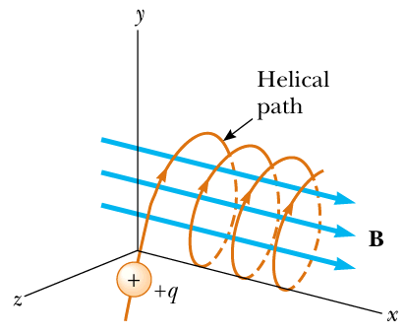
Motivation: plasma edge simulation
Scale separation due to the magnetic field
Different dynamics in the parallel and perpendicular directions
Strongly anisotropic equations
Typical approach for solving plasma-edge fluid equations is to align the mesh with the magnetic field
Notes:
However, even with the fluid approach, plasma edge modelling is a challenging one. In fact, the presence of the magnetic field produce a scale separation that leads to different dynamics in the parallel and perpendicular directions. Hence, the plasma fluid equations are strongly anisotropic. The typical approach for solving plasma edge fluid equations is to align the computational mesh with the magnetic field. This guarantees that no numerical diffusion is introduced in the perpendicular direction.

Slide 5
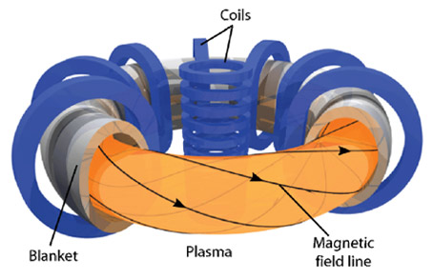
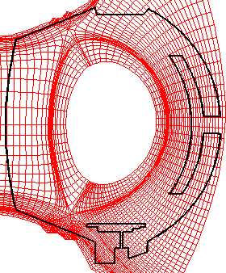
Mesh alignment?
Tokamak topology allows to separate a poloidal and a toroidal numerical approach
Poloidal plane
Toroidal direction
Impossible to align for real configuration (irrational winding up of the magnetic lines)
Local non alignment→ what is the numerical error introduced?
Other approaches are possible (Fourier series…)
Alignment is possible, but…
Difficult to deal with real geometries (penalization..)
Difficult to simulate X-point configurations
Plasma center
No evolving magnetic fields
SOLEDGE2D mesh
Schemes based on non aligned grids
Mostly based on finite-differences
Non-aligned or aligned interpolations
Structured meshes (ok for toroidal discretization, not for the poloidal)
[Gunter 2005]
[Van Es 2014]
[Stegmeir 2015]
Notes:
However, let’s take a look on the matter of aligning the computational mesh with the magnetic lines. The tokamak topology allows us to separate a poloidal and a toroidal numerical approach. If we focus on the poloidal plane, it is certainly possible to align the mesh. Here for example you can see a computational mesh used by the code soledge2d. However, there are several drawback with this technique: firstly it is difficult to simulate real tokamak geometries, and also realistic magnetic field configurations, such as the X-point. Another drawback is related to the simulation of the plasma center, since the mesh alignment brings a singularity at the tokamak center. And finally, evolving magnetic configurations are very costly since we need to regenerate the mesh at each time step. If we consider now the toroidal direction, it turns out that it is impossible to align completely the mesh for real magnetic configurations, because the winding-up of the magnetic lines is irrational. So there will be always some local non alignment, and the problem is that we are not controlling the error introduced by this local non alignment. I would like also to mention that in the toroidal direction there are also other approaches possible, such as for example the use of Fourier series, but I am not considering them in this talk. So, to overcome the limitations of aligning the mesh, a bunch of numerical schemes based on non aligned grids were introduced in the past. I put here a couple of references, they are mostly based on finite-differences, and they rely either on a proper choice of the stencil either on aligned interpolation to reduce the numerical diffusion introduced by the non-aligned grid. Since they are based on finite differences, they are well suited for the toroidal discretization but not for the poloidal.

Slide 6
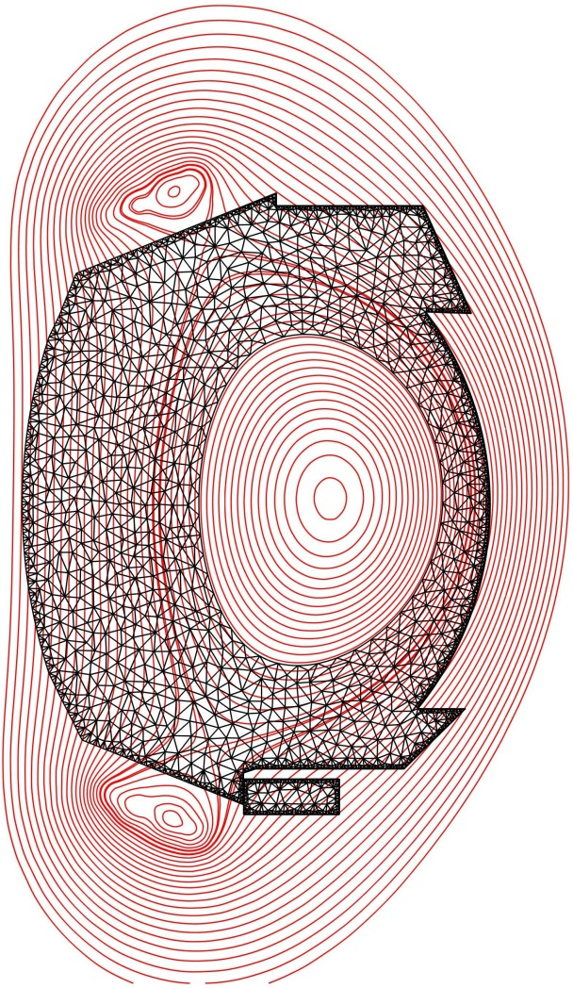
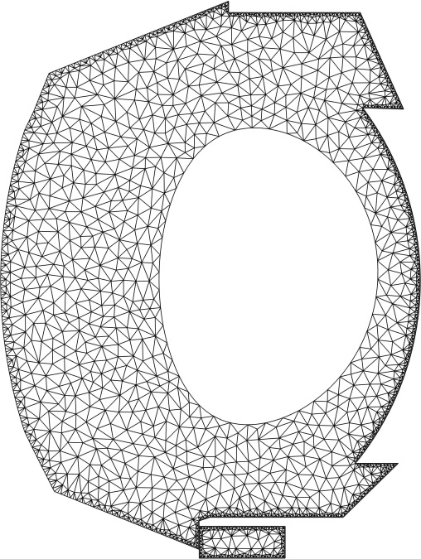
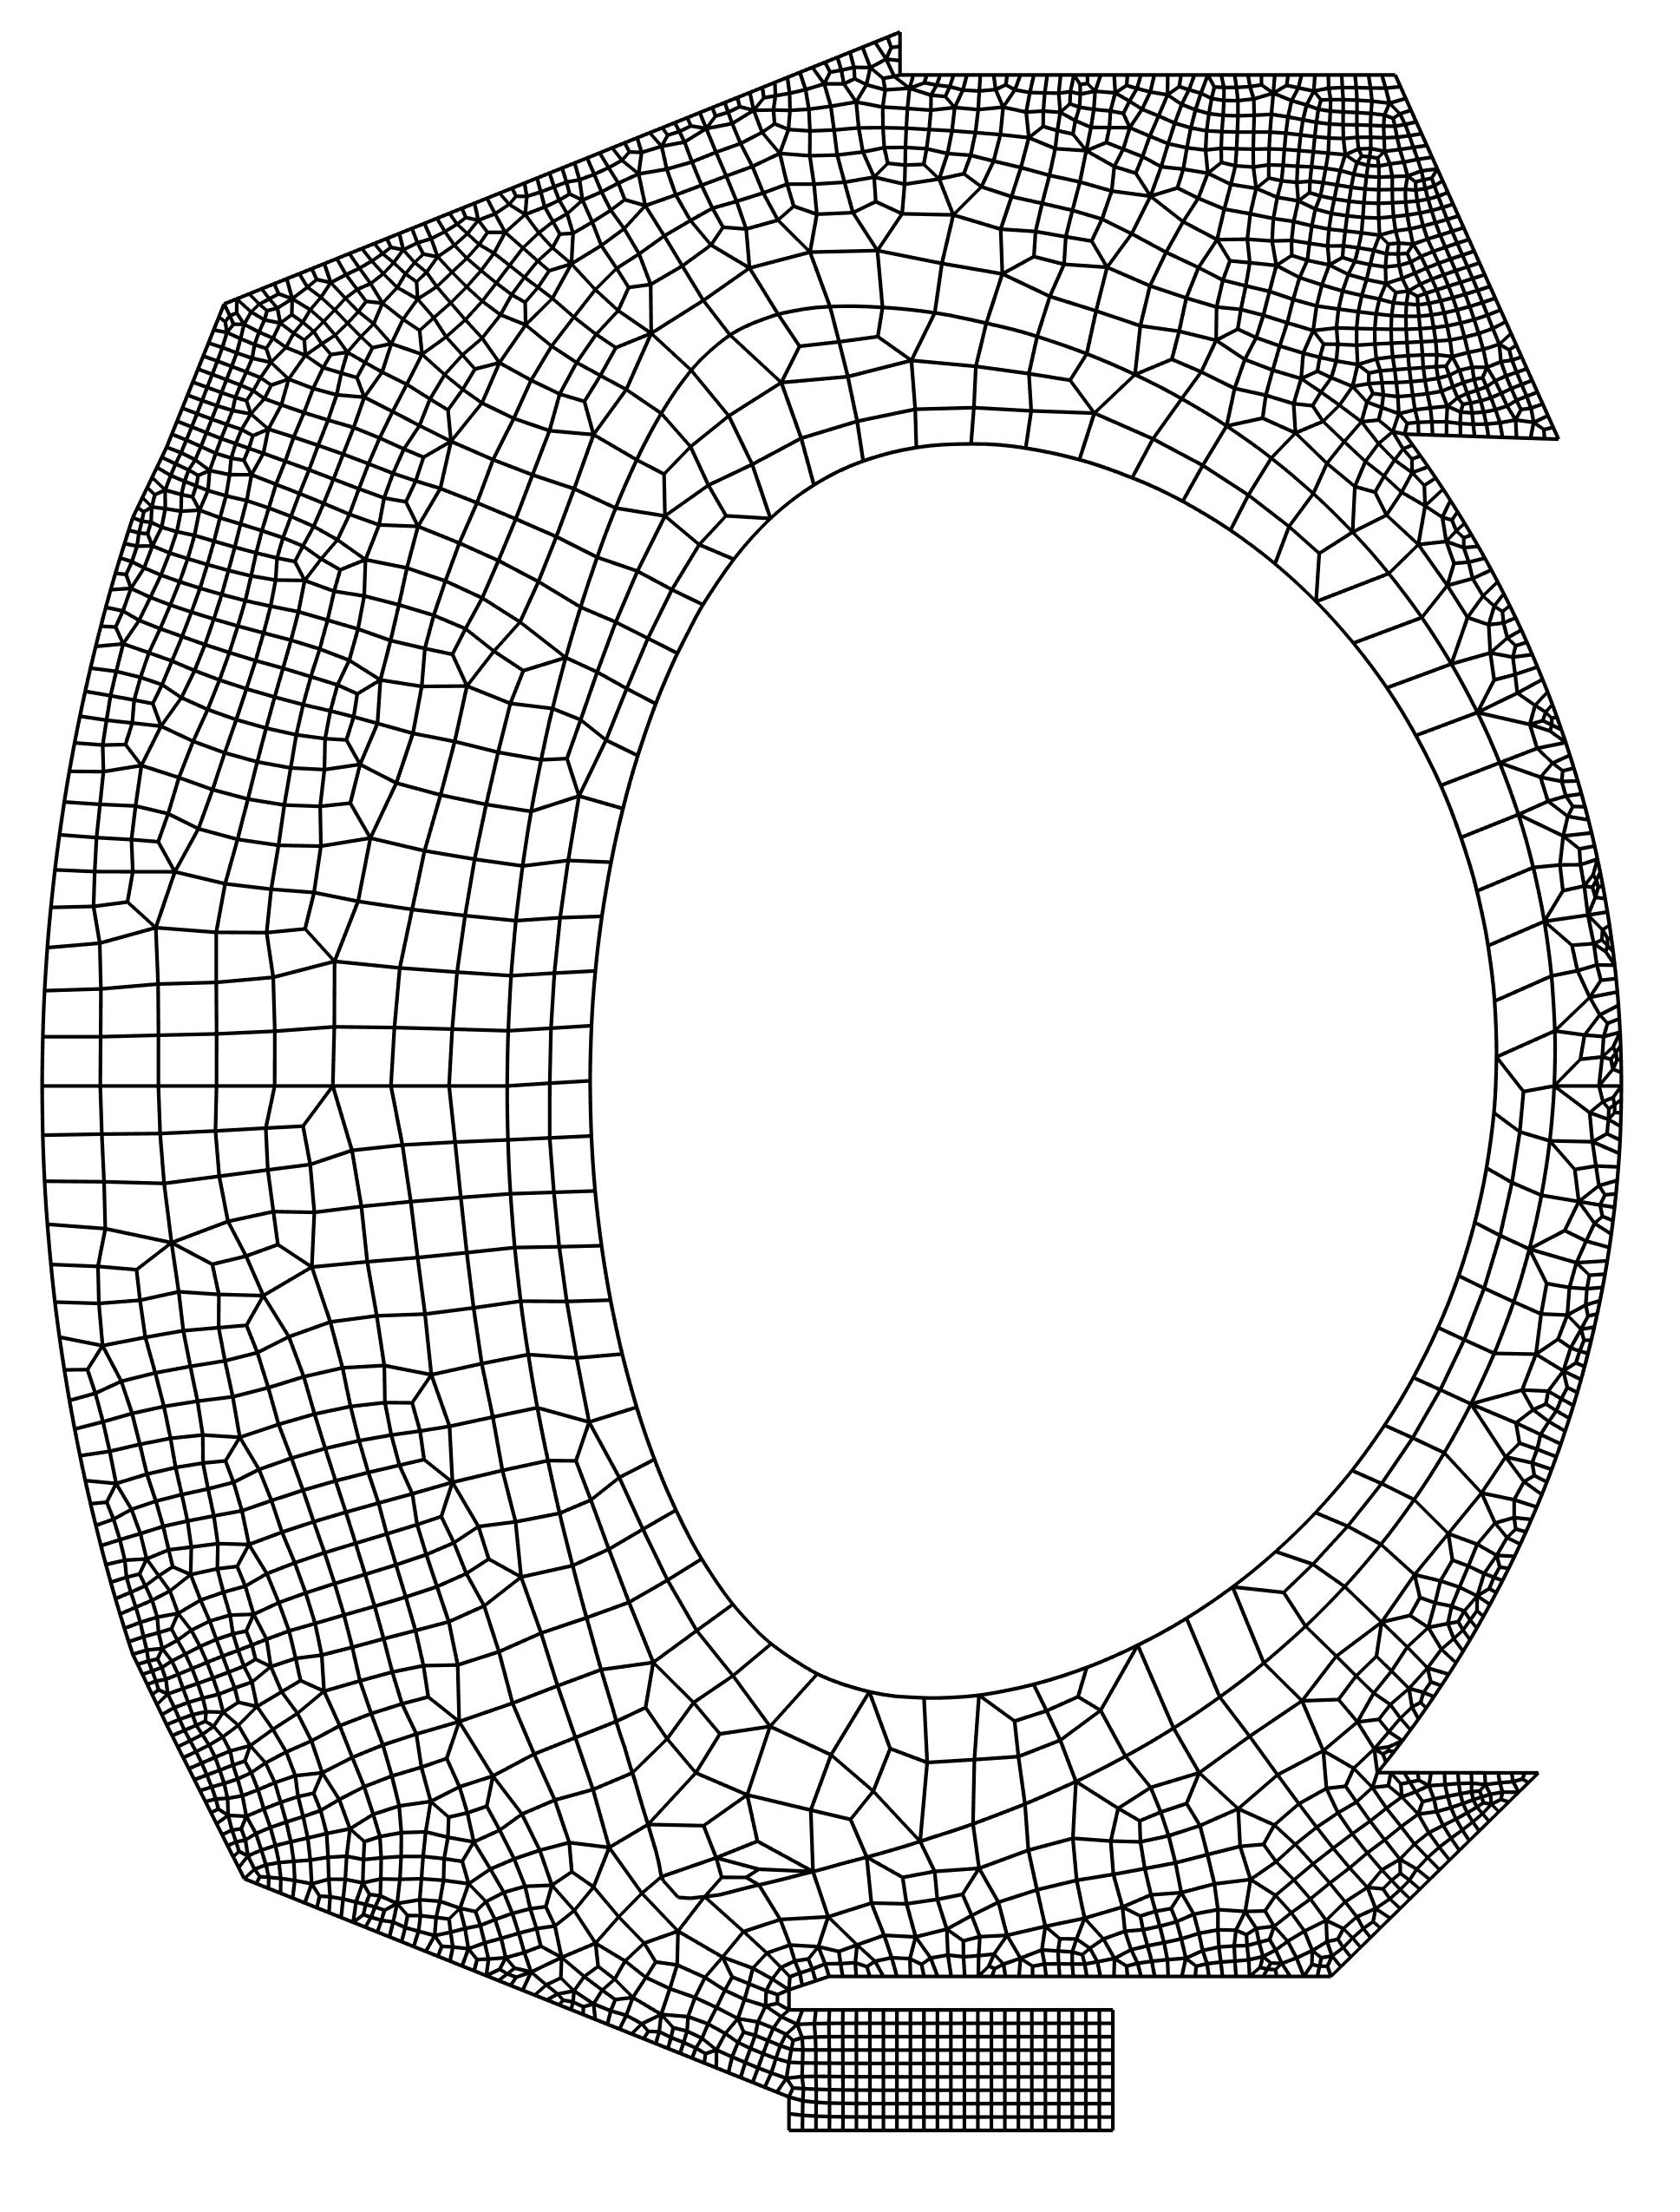
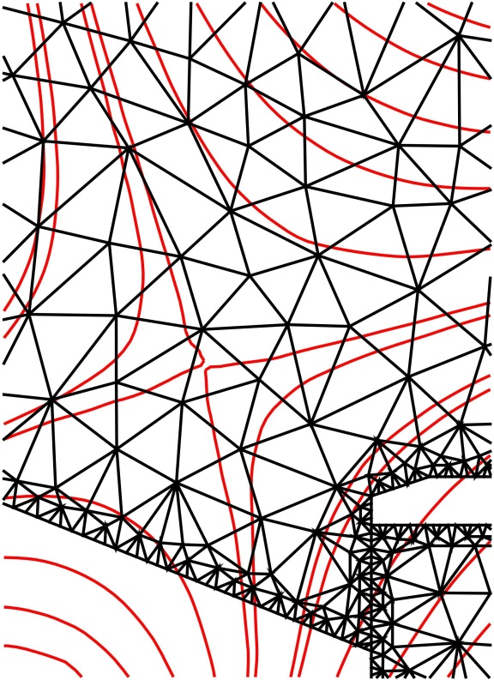

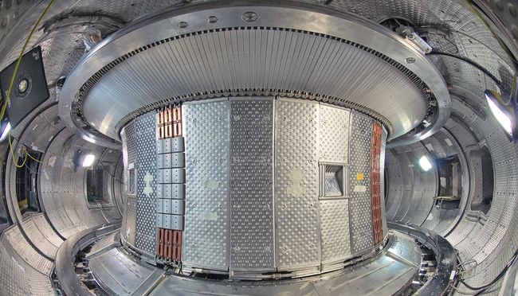
A novel approach: high-order schemes on unstructured meshes
5
Unstructured non-aligned meshes
Easy definition of the geometry, high accuracy (curved elements).
Able to deal with any magnetic configuration.
Computation up to the center of the machine.
Tokamak WEST
Notes:
In this work, we wanted to investigate a novel approach, that is, the use of high-order schemes on unstructured non-aligned meshes. So we want to completely abandon the idea of aligning the mesh. Here for example I put the two unstructured meshes of the poloidal plane of the tokamak WEST, that you can see in this picture, so you can see that using unstructured meshes I can define very easily and accurately the geometry, I can also use curved elements to follow this boundary without the need of refining the mesh, and I can compute any magnetic configuration. Here you can see that there is nothing to do to deal with a X-point configuration. Finally, I can compute until the center of the machine.

Slide 7
Outline
Motivation of the work
The HDG scheme in a nutshell
High-order and numerical diffusion
Numerical tests on real geometries/magnetic configurations

Slide 8
The numerical scheme: hybrid discontinuous Galerkin (HDG)
What is a discontinuous Galerkin method
A finite element method based on a discontinuous solution element-by-element.
Introduced in the ’70s by Reed and Hill.
Continuity is not embedded in the space of the solutions but it is imposed weakly by means of numerical fluxes.
Classic (continuous) finite element scheme (CG)
Discontinuous Galerkin (DG)
Why a DG scheme for plasma transport?
Stable and robust scheme (stabilization introduced by the numerical fluxes).
No need to introduce stabilization terms.
Highly parallelizable.
Easy adaptivity.
Duplicated nodes
Notes:
The numerical scheme that we decided to use is a hybrid discontinuous Galerkin scheme, HDG. So first of all, what is a discontinuous Galerkin method? It is a finite element method based on a discontinuous solution element-by-element. It was introduced in the 70’ by Reed and Hill, so it is not something really new, and the continuity between the elements is not embedded in the space of the solution, but it is imposed in a weak form by means of numerical fluxes. . With respect to a continuous finite element method, we have the duplication of the border nodes with some numerical fluxes that are used to impose the continuity. The advantages of DG with respect to a normal finite element scheme are, firstly, the inherent stabilization introduced by the numerical fluxes, which is very useful for equations with a strong convective component, such as the plasma fluid equations. In particular, we don’t need to add special terms to the weak form to stabilize the discretization. DG schemes are also highly parallelizable and the discontinuous character of the solution makes easy also the implementation of adaptive techniques

Slide 9
The numerical scheme: hybrid discontinuous Galerkin (HDG)
What does hybrid mean and why HDG?
Hybrid method: unknowns in the elements and on the edges (element borders).
Static condensation properties (-> linear systems involve only DOF on the edges).
Coupled unknowns
in HDG
Coupled unknowns
in DG
Notes:
Finally, what does hybrid means and why we want to use HDG ? A hybrid method is a finite element method in which we have unknowns in the elements and unknowns in the edges, that is, the borders of the elements. This means that we can use a static condensation technique that reduces the coupled degrees of freedom to those that lay on the edges of the mesh. Here you can see the coupled degrees of freedom for HDG in a two elements mesh of degree 6, that are the red ones, and in blu the coupled degrees of freedom with a normal discontinuous Galerkin scheme. It is clear that this procedure allows to reduce the linear system produced by the discretization, in particular for high-order elements.

Slide 10
Outline
Motivation of the work
The HDG scheme in a nutshell
High-order and numerical diffusion
Numerical tests on real geometries/magnetic configurations
Notes:
Let’s talk now about high-order and numerical diffusion

Slide 11
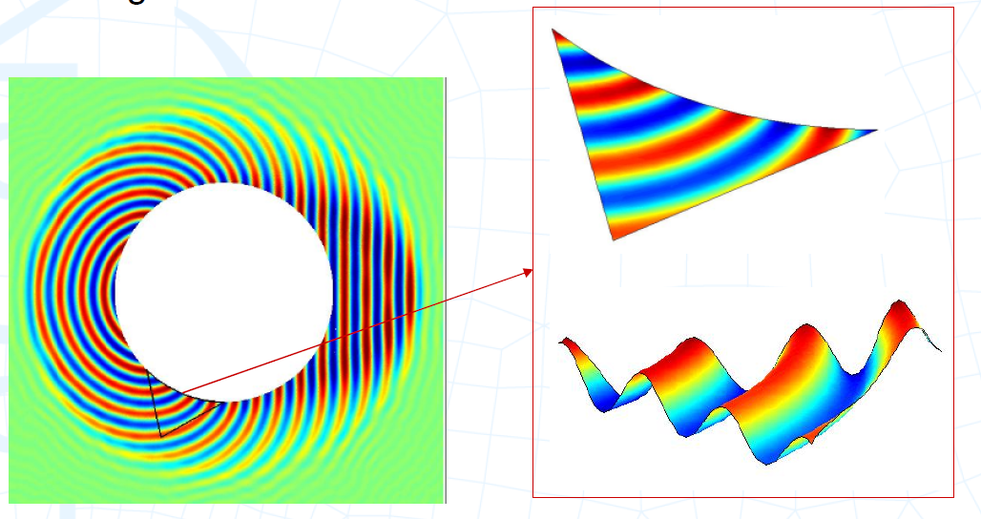
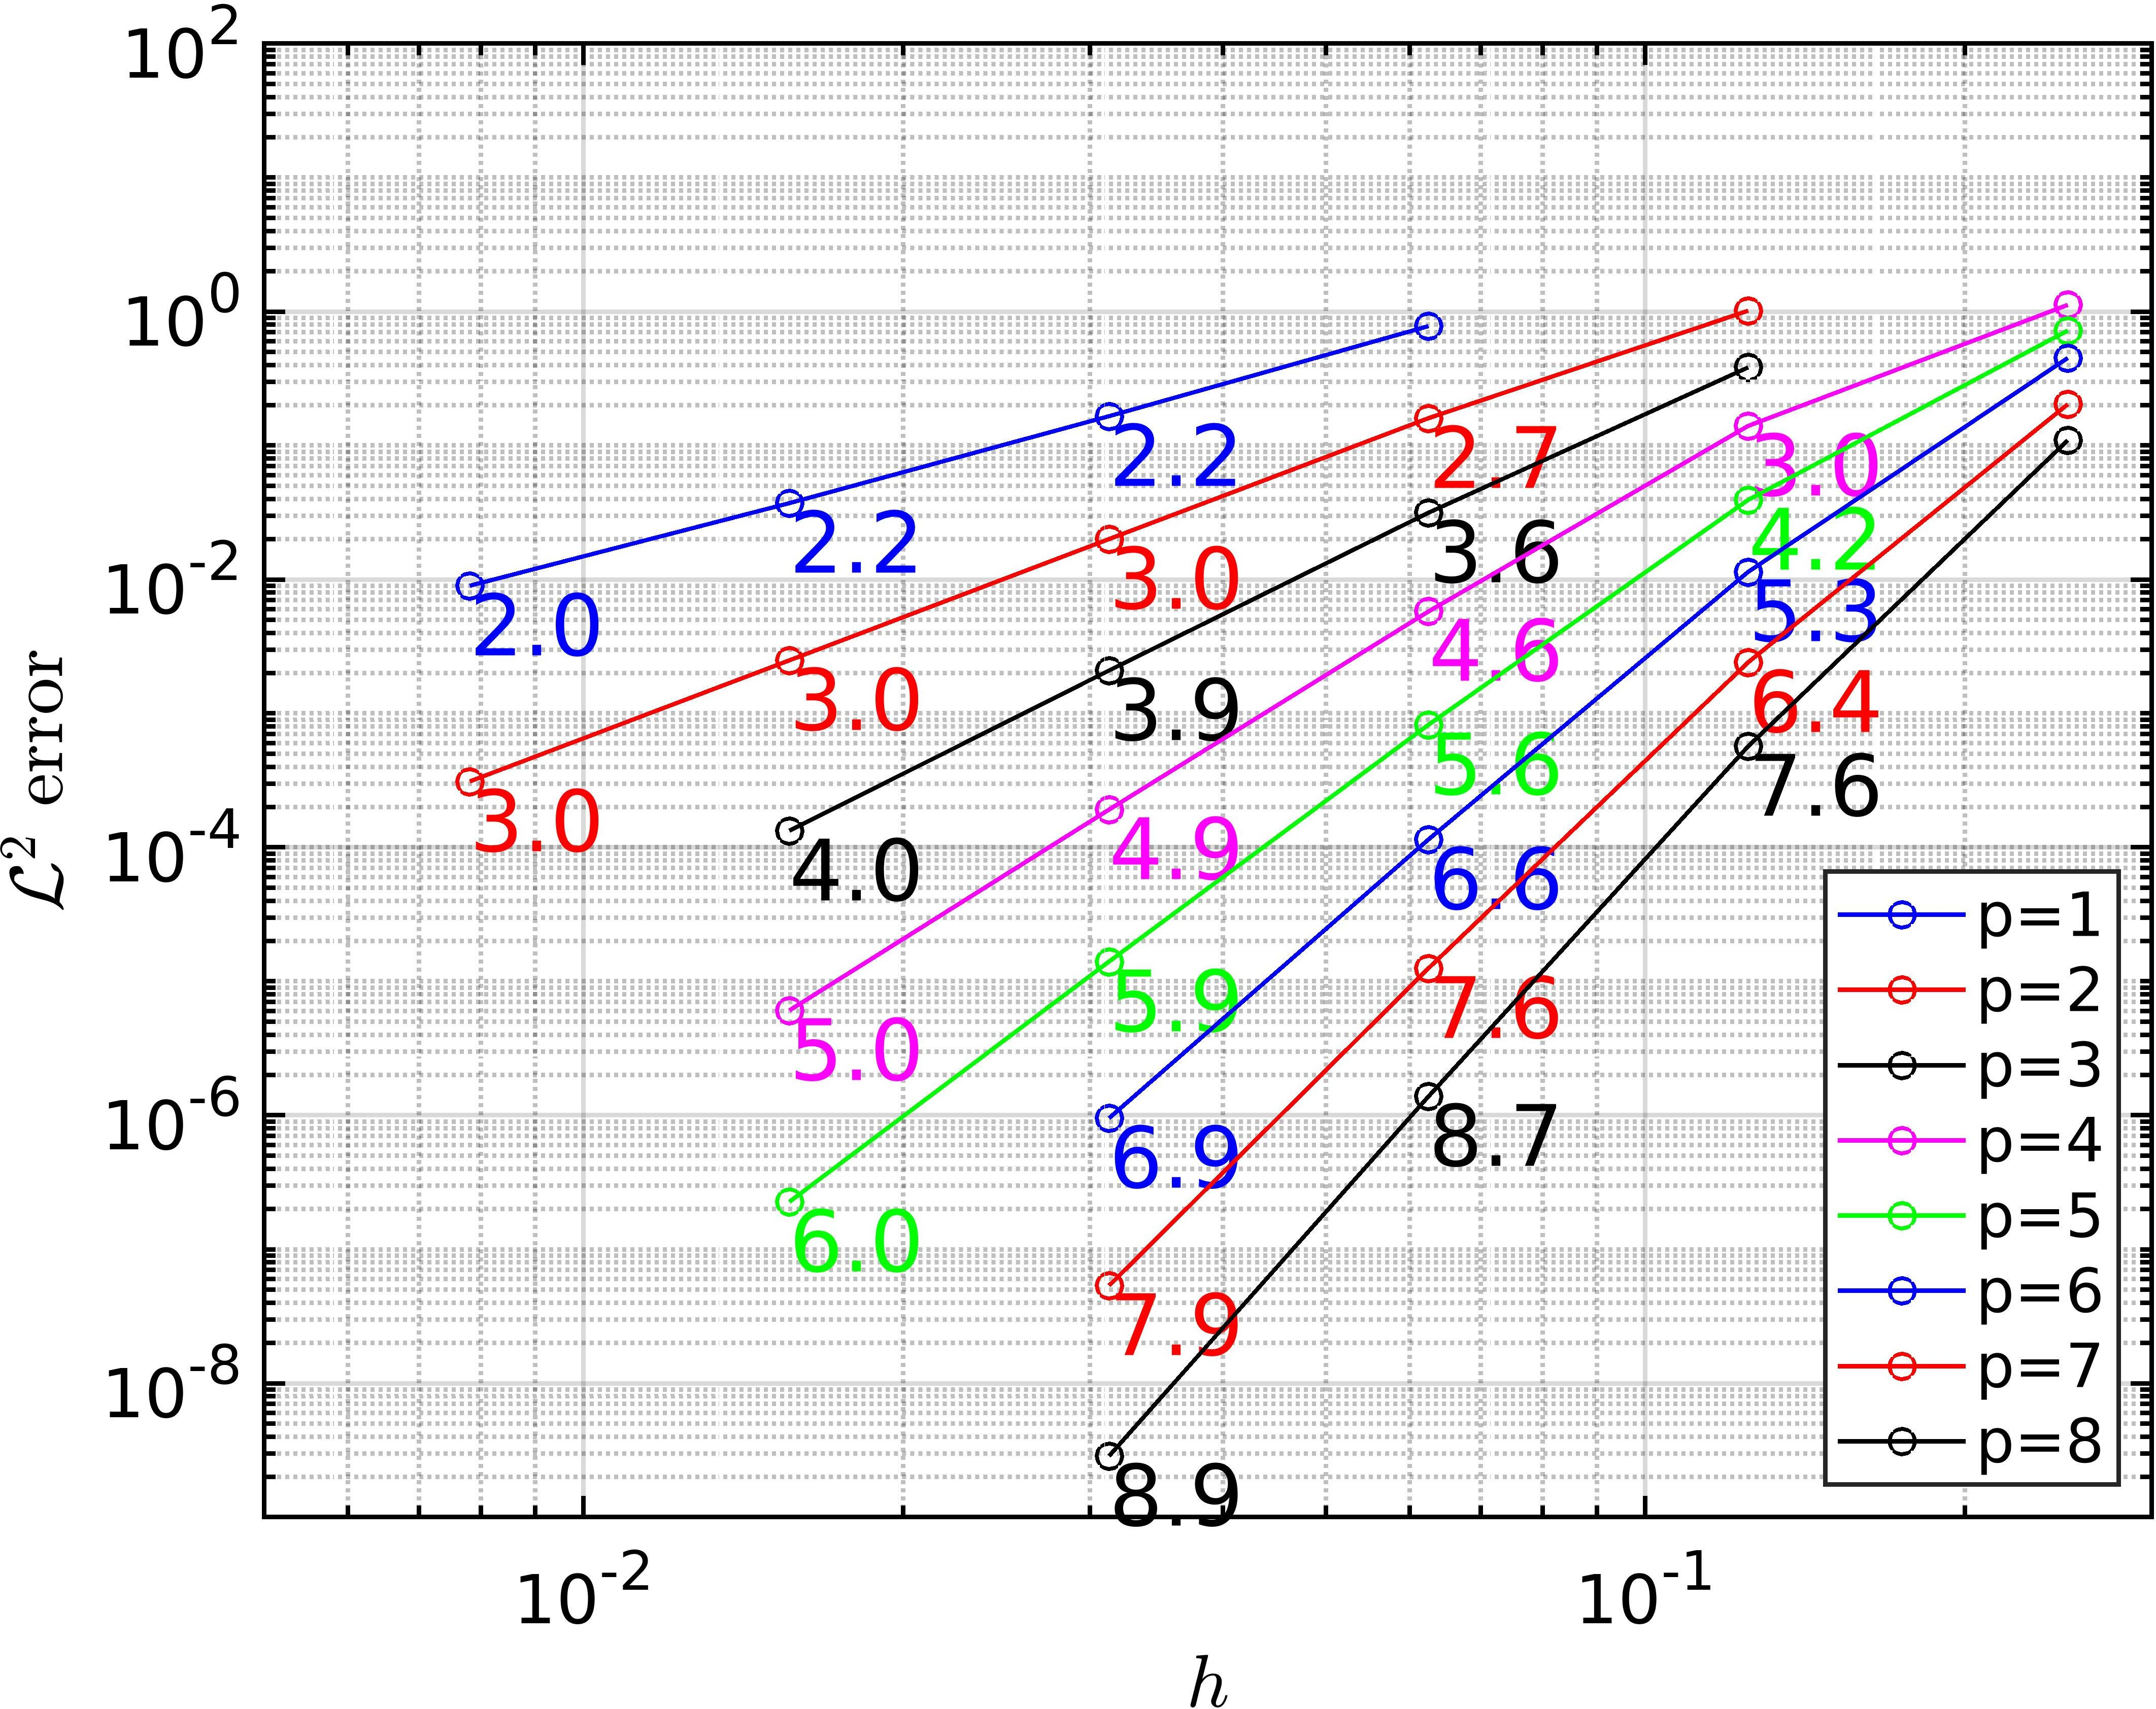
High-order and numerical diffusion
The solution is interpolated in each element with an high-order polynomial (typically p>2)
Allows to capture several features in a single element
Wave problem
Convergence rate p+1
Question: are high-order computations suited for reducing the numerical diffusion with non-aligned meshes and strongly anisotropic problems?
Provides high-order convergences
Notes:
I am using polynomial interpolation, so high-order means that the solution is interpolated with high-order polynomials in each element. This provide high-order convergence curves of order p+1. We can also post-process the solution to obtain a super-convergent solution with order p+2. High-order elements allow to capture several feature of the solution with coarse meshes, and in general they allow to reduce the computational cost for a given level of accuracy. The question I would like to answer now is this one: are high-order computations suited for reducing the numerical diffusion with non-aligned meshes and strongly anisotropic problems?

Slide 12

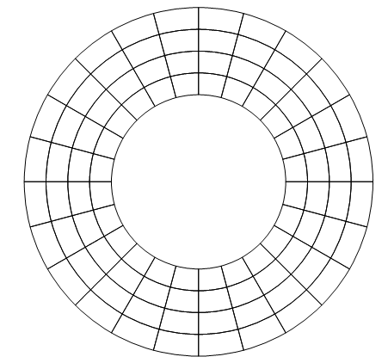
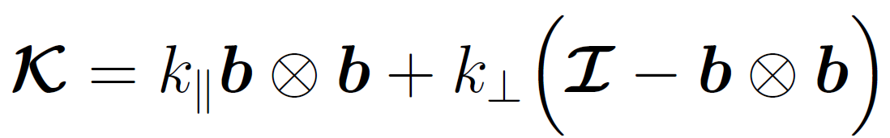
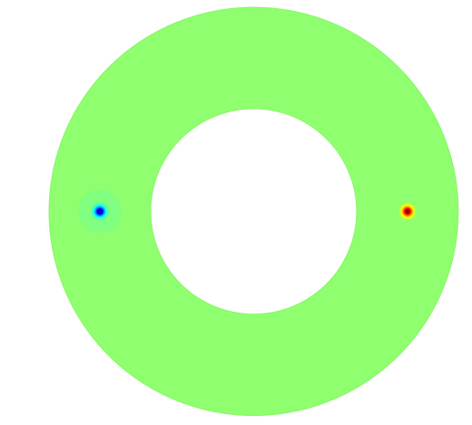
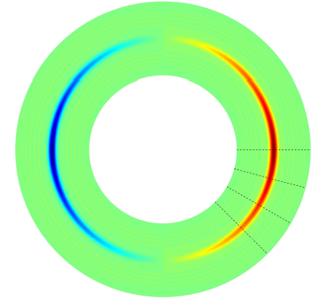
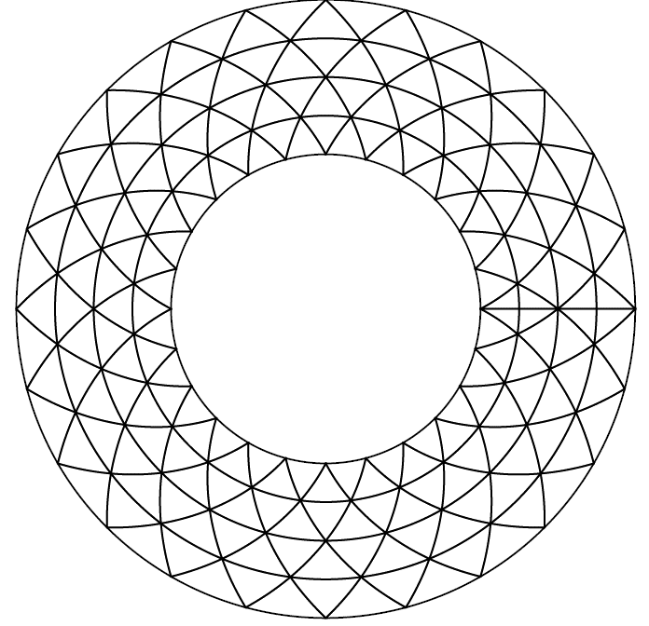
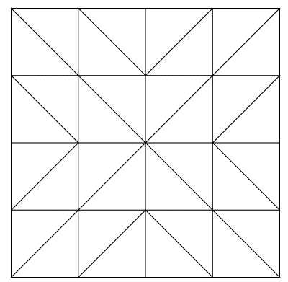

High-order and numerical diffusion
Problem statement: diffusion of a Gaussian source
Aligned mesh
Non-aligned mesh
Quads
Magnetic field direction
Strong anisotropy
$$\frac{k_{∥}}{k_{⊥}}={10}^{9}$$
Triangles
b
sink
source
Circular magnetic field
sections
Notes:
I am proposing here a numerical test where I solve a simple diffusion problem with a strong anisotropy, and I consider a source and a sink and a circular magnetic field. I will use aligned meshes of triangles or quads as in this picture, or non aligned meshes like this ones. The solution of this problem is this one, where the solution is diffused from the source to the sink following the magnetic lines. The spreading of the solution in the radial direction is due to the numerical diffusion introduced by the discretization, and can be visualized taking sections of the solution at different angular locations.

Slide 13
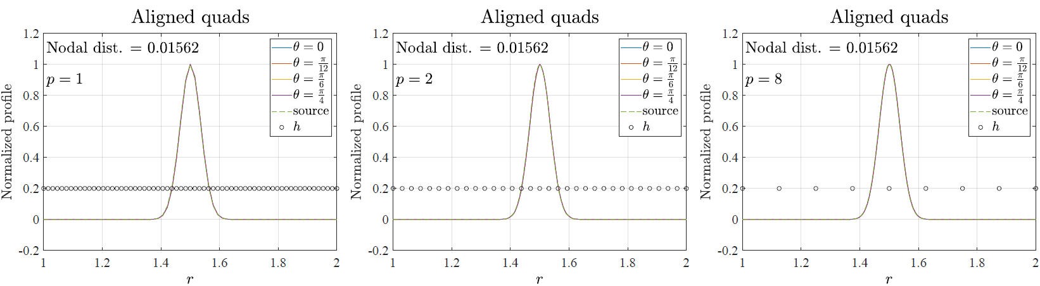
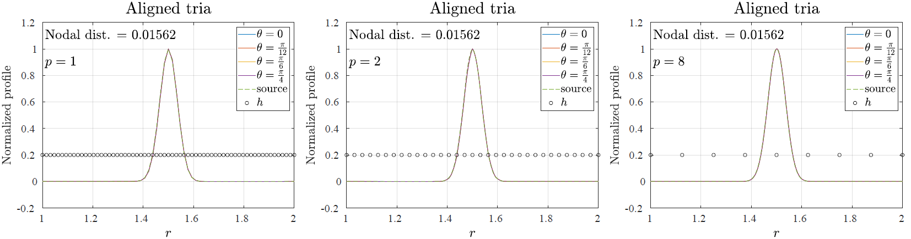
High-order and numerical diffusion: aligned meshes
The nodal distance is the same for all the meshes!!
QUADS p=1
QUADS p=2
QUADS p=8
Element size
Element size
Element size
TRIA p=1
TRIA p=2
TRIA p=8
Element size
Element size
Element size
Notes:
Here are the results with aligned meshes, on the upper line are quads and the lower are triangles. These are p1, this p2 and this p8. All the meshes considered have the same number of nodes, so for example for p8 I am using much larger elements than p1 and p2. So you can see that, for all the computations, no numerical diffusion is introduced by the discretization, which was expectable, since the mesh are aligned here.

Slide 14
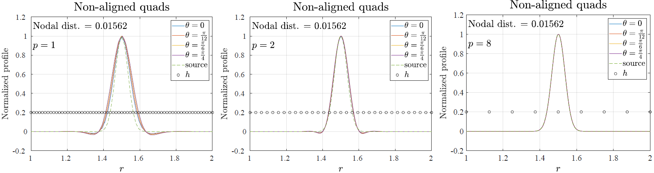
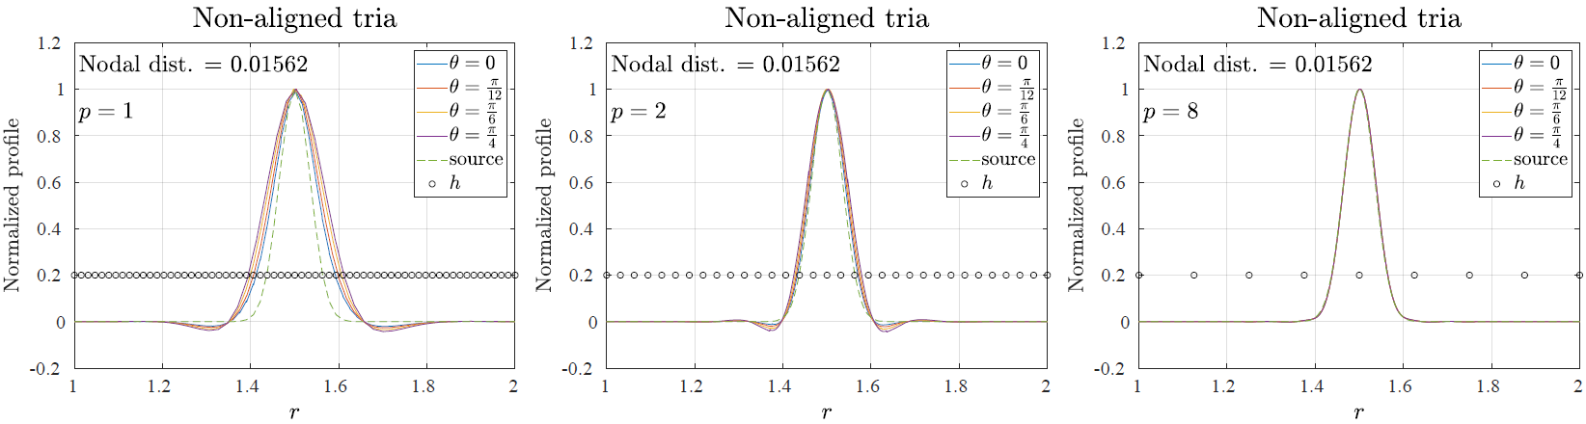
High-order and numerical diffusion: non-aligned meshes
The nodal distance is the same for all the meshes!!
QUADS p=1
QUADS p=2
QUADS p=8
Element size
Element size
Element size
TRIA p=1
TRIA p=2
TRIA p=8
Element size
Element size
Element size
Notes:
If now we see the results with non aligned meshes, see what happens: with p1 we have a lot of numerical diffusion, and also with p2, even if it’s better than p1. However, with p8 we recovered the correct solution. Remember that p8 computations have the same number of nodes than p1 and p2, and moreover thanks to the hybridization technique that I showed you, the p8 computations produce a much smaller linear system than p1.

Slide 15
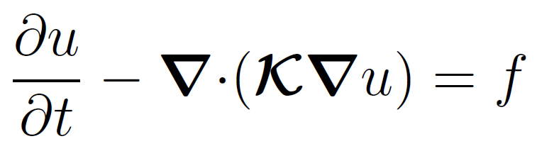
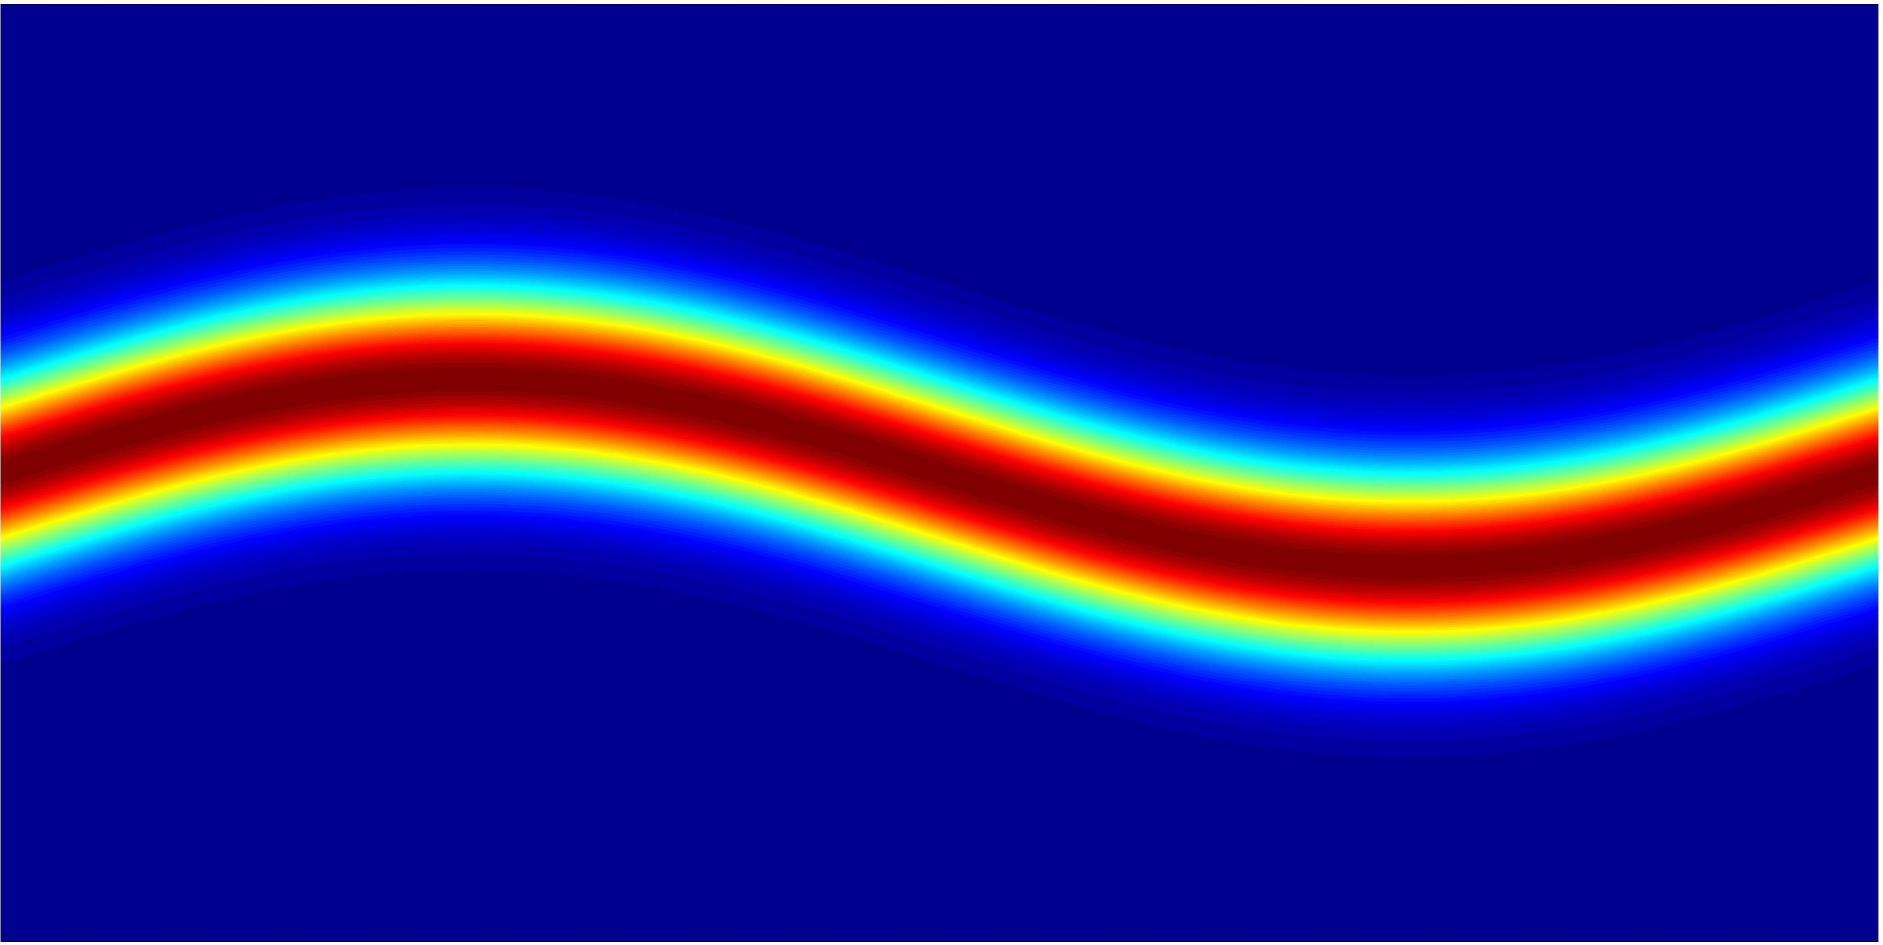
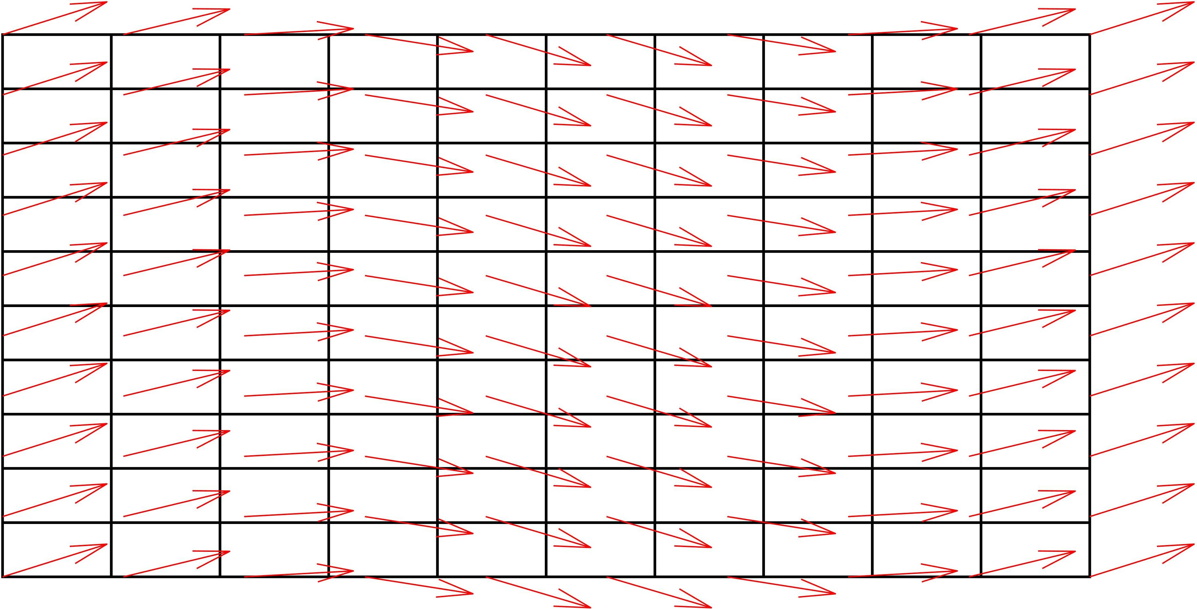
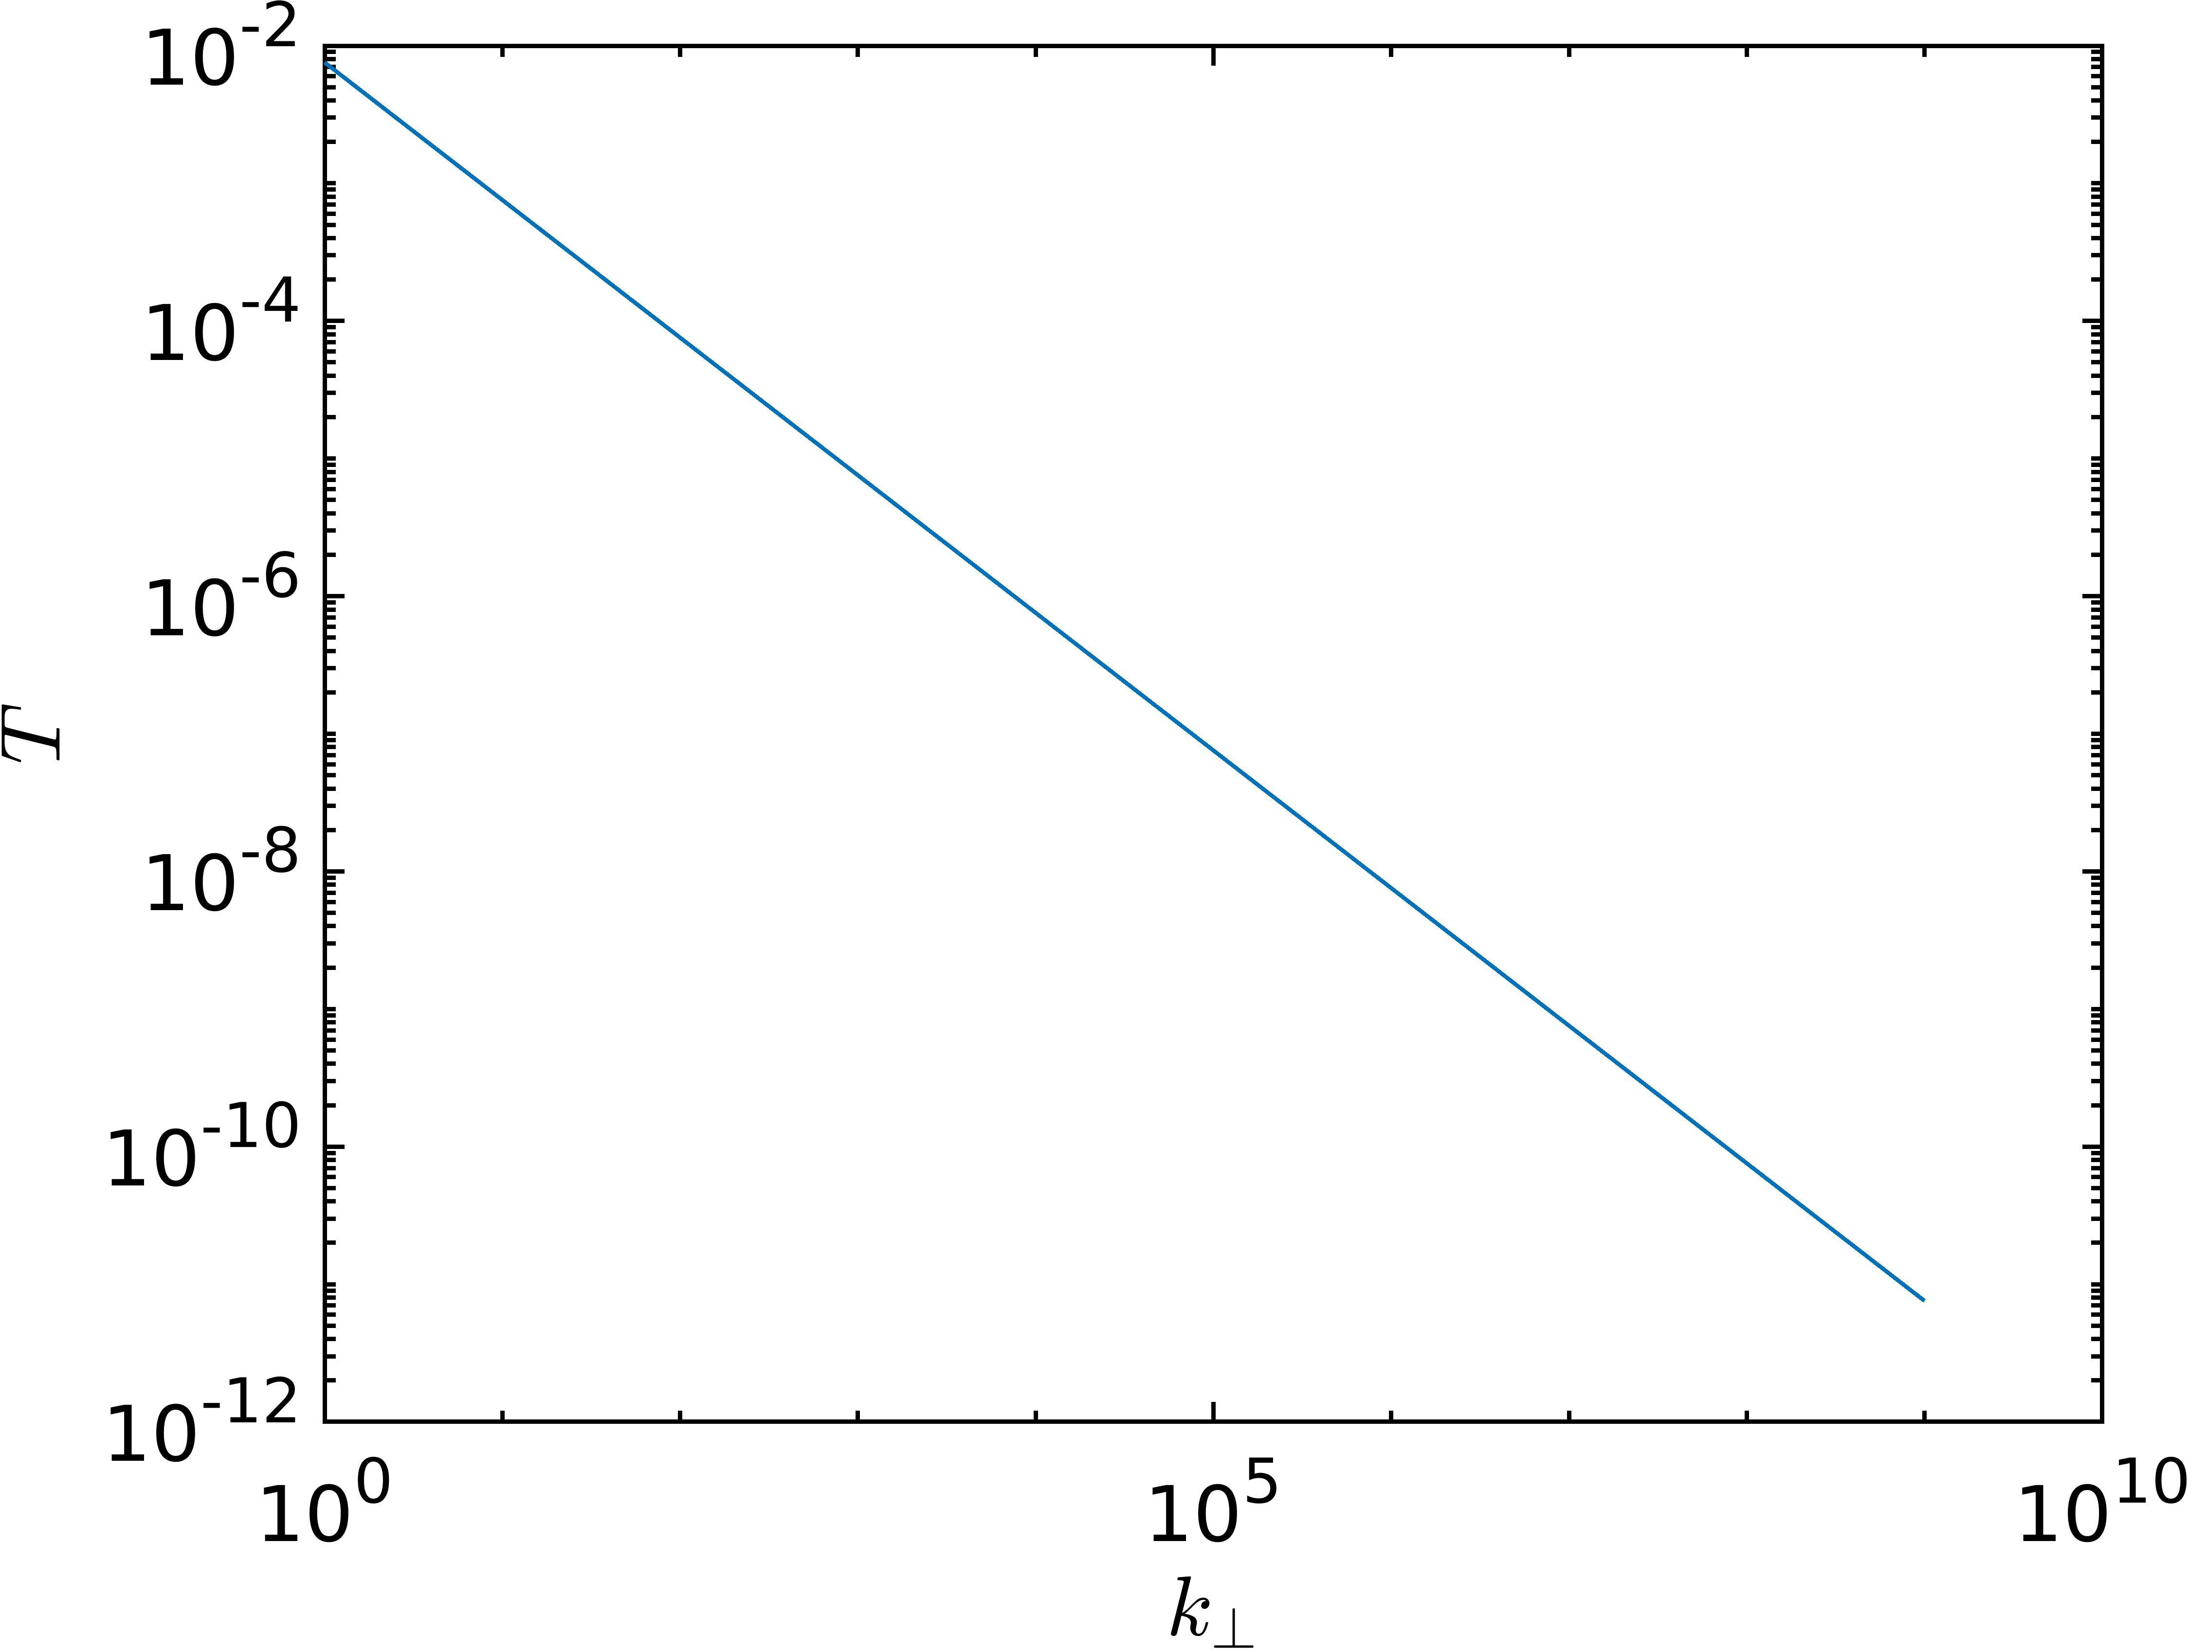
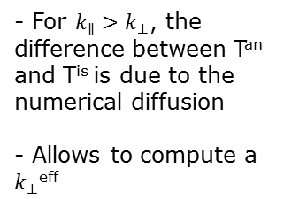




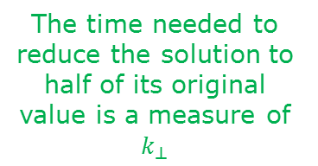
High-order and numerical diffusion: estimation of the numerical diffusion
Time evolving case
The time needed to reduce the solution to half of its original value is a measure of $k_{⊥}$
Aligned solution
T=A/$k_{⊥}$
Evaluated with isotropic computations $k_{∥}$=$k_{⊥}$
- For $k_{∥}>k_{⊥}$, the difference between T^{an} and T^{is} is due to the numerical diffusion
- Allows to compute a $k_{⊥}$^{eff}
b
T^{is} = A/$k_{⊥}$
Poloidal
T^{an}
$k_{⊥}$^{eff}
Toroidal
Notes:
I would like to show you another test where I try estimate the numerical diffusion introduced by the discretization. So the previous test could be seen as a discretization of the poloidal section of a tokamak, in this case I would like to focus on the toroidal one. The solution is a Gaussian aligned with the magnetic field, so with a bit of imagination you can think about it as a filament of plasma elongated in the toroidal direction and following the magnetic lines. I solve in this case a time evolving diffusion equation, so I compute the time needed to this solution to diffuse until its maximum value became the half of the initial one. This time is a measure of the perpendicular diffusion, and we can estimate the law relating this reference time with the perpendicular diffusion using isotropic computations. Then if we do the same using anisotropic computation, the new reference time provide an estimation of the effective perpendicular diffusion introduced by the discretization.

Slide 16

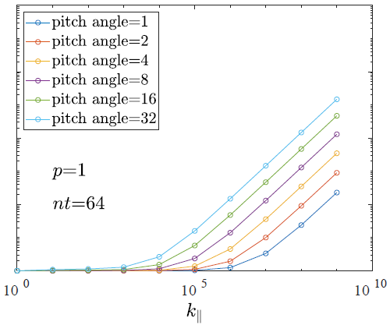
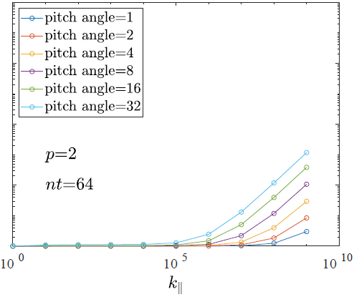
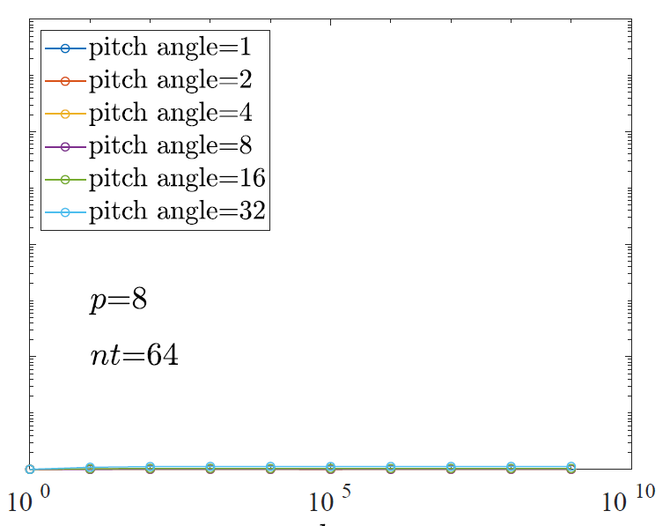









High-order and numerical diffusion: estimation of the numerical diffusion
$$64 nodes in the toroidal direction$$
$k_{⊥}$^{eff}
$k_{⊥}$^{eff}
$k_{⊥}$^{eff}
10⁸
10⁸
10⁸
64 elements
P=1
32 elements
P=2
8 elements
P=8
10⁶
10⁶
10⁶
10⁴
10⁴
10⁴
$k_{⊥}=1$
$k_{⊥}=1$
$k_{⊥}=1$
10²
10²
10²
10⁰
10⁰
10⁰
10⁰
10⁵
10¹⁰
10⁰
10⁵
10¹⁰
10⁰
10⁵
10¹⁰
$$k_{∥}$$
$$k_{∥}$$
$$k_{∥}$$
Pitch angle: max angle between the mesh and the magnetic field
Notes:
Here are the results in term of effective k_per in a set of anisotropic simulations with parallel diffusion spanning from 1 to 10^9 and perpendicular diffusion equal to 1. In all this simulation I am putting 64 nodes in the toroidal direction. So you can see that if we use 64 elements of degree 1, we have an effective diffusion can be huge, 10^6 almost. It also depends on the pitch angle, but even for very small angles, for example degree 1, the real perpendicular diffusion in our computation can be 100 times larger than the physical one. So the local non alignments, that I was mentioning in the introduction, can produce large errors in the computation. The situation improves already if we use p=2 elements, so in this case 32 elements of degree 2, and with 8 element of degree 8 we can just forget about the non-alignment, there is no error introduced.

Slide 17
Outline
Motivation of the work
The HDG scheme in a nutshell
High-order and numerical diffusion
Numerical tests on real geometries/magnetic configurations

Slide 18
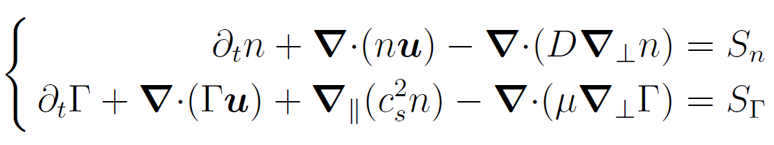
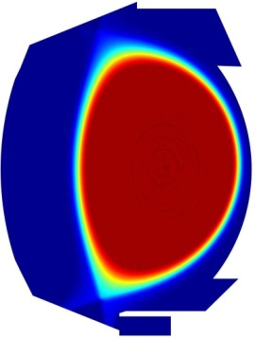
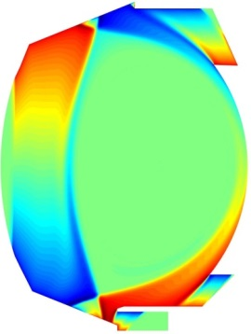
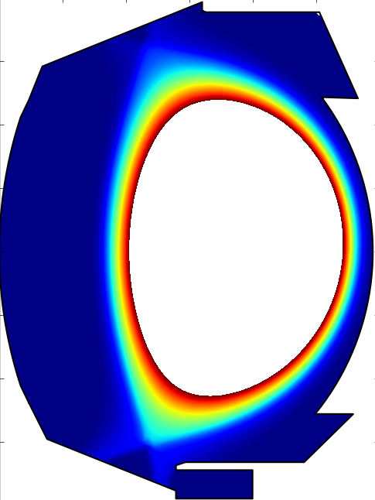
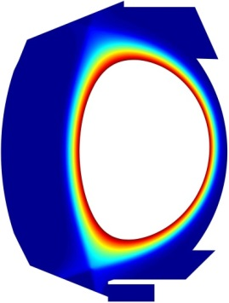
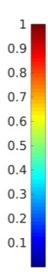
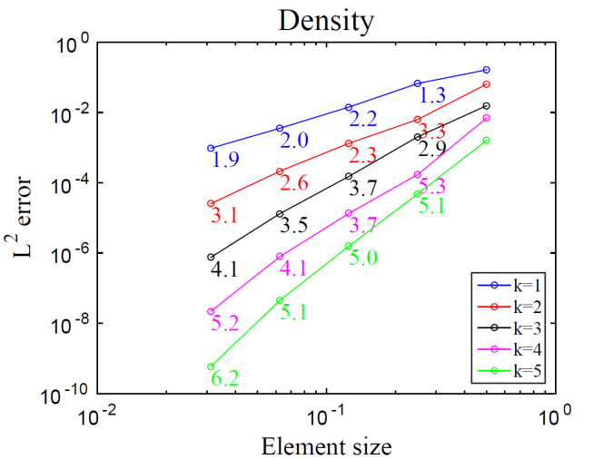
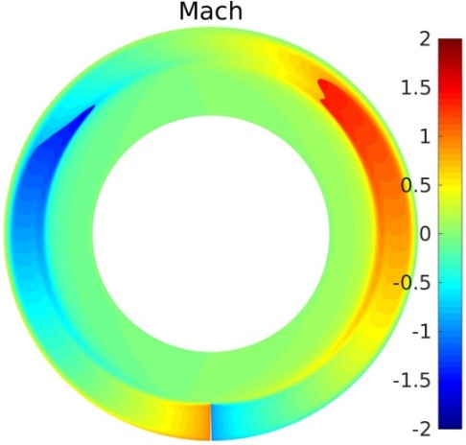
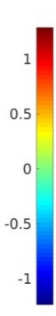
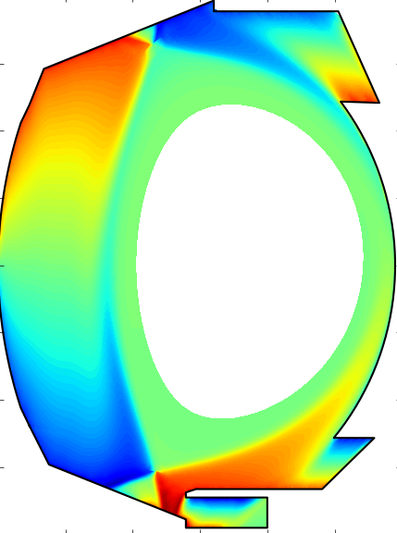
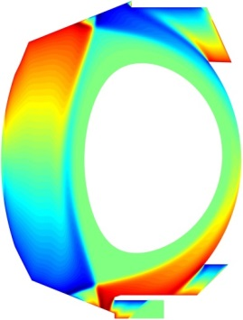
Numerical test: isothermal plasma model
Computations up to the center
Giorgiani et al. , JCP, 2018
High-order HDG scheme
Coded in Fortran
MPI/OpenMP parallelization
Blas/Lapack + PastiX libraries
Validation with SOLEDGE
SOLEDGE2D
HDG
Verification with MMS
Very low diffusion solutions, shocks
Density
Mach//
Diffusion ~0.08 m²/s
Notes:
I started developing the HDG scheme using a very simple model, which is a two dimensional axisymmetric, and isothermal model. I implemented the scheme using high order discretizations, and I can use triangular or quadrangular meshed. It is coded in Fortran with MPI/OpenMP parallelization, and it’s linked to optimized library for the linar algebra, blas and lapack, and I use PastiX for the linear system solution. Here I am showing the verification of the code, and you can see from this convergence curves that I obtain the correct order of convergence for all the polynomial degress considered. Here I am showing the validation with the code SOLEDGE, and you can see that we obtain very similar results between the two codes for the plasma quantities in the domain. We have showed that we can compute until the plasma center, which is a completely new capability in the landscape of fluid solvers for the plasma edge, and finally, we can deal with very low diffusions and also with shocks in the solution, as shown in this picture. We have published a paper recently on this work.

Slide 19
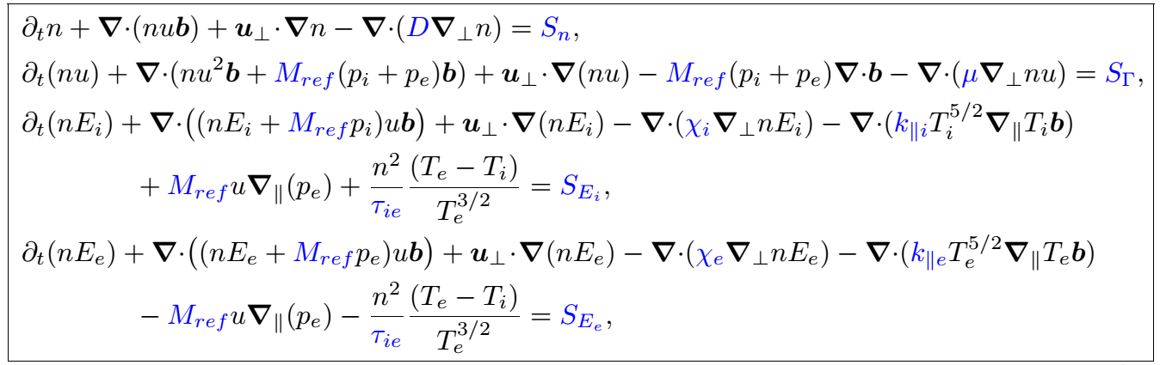
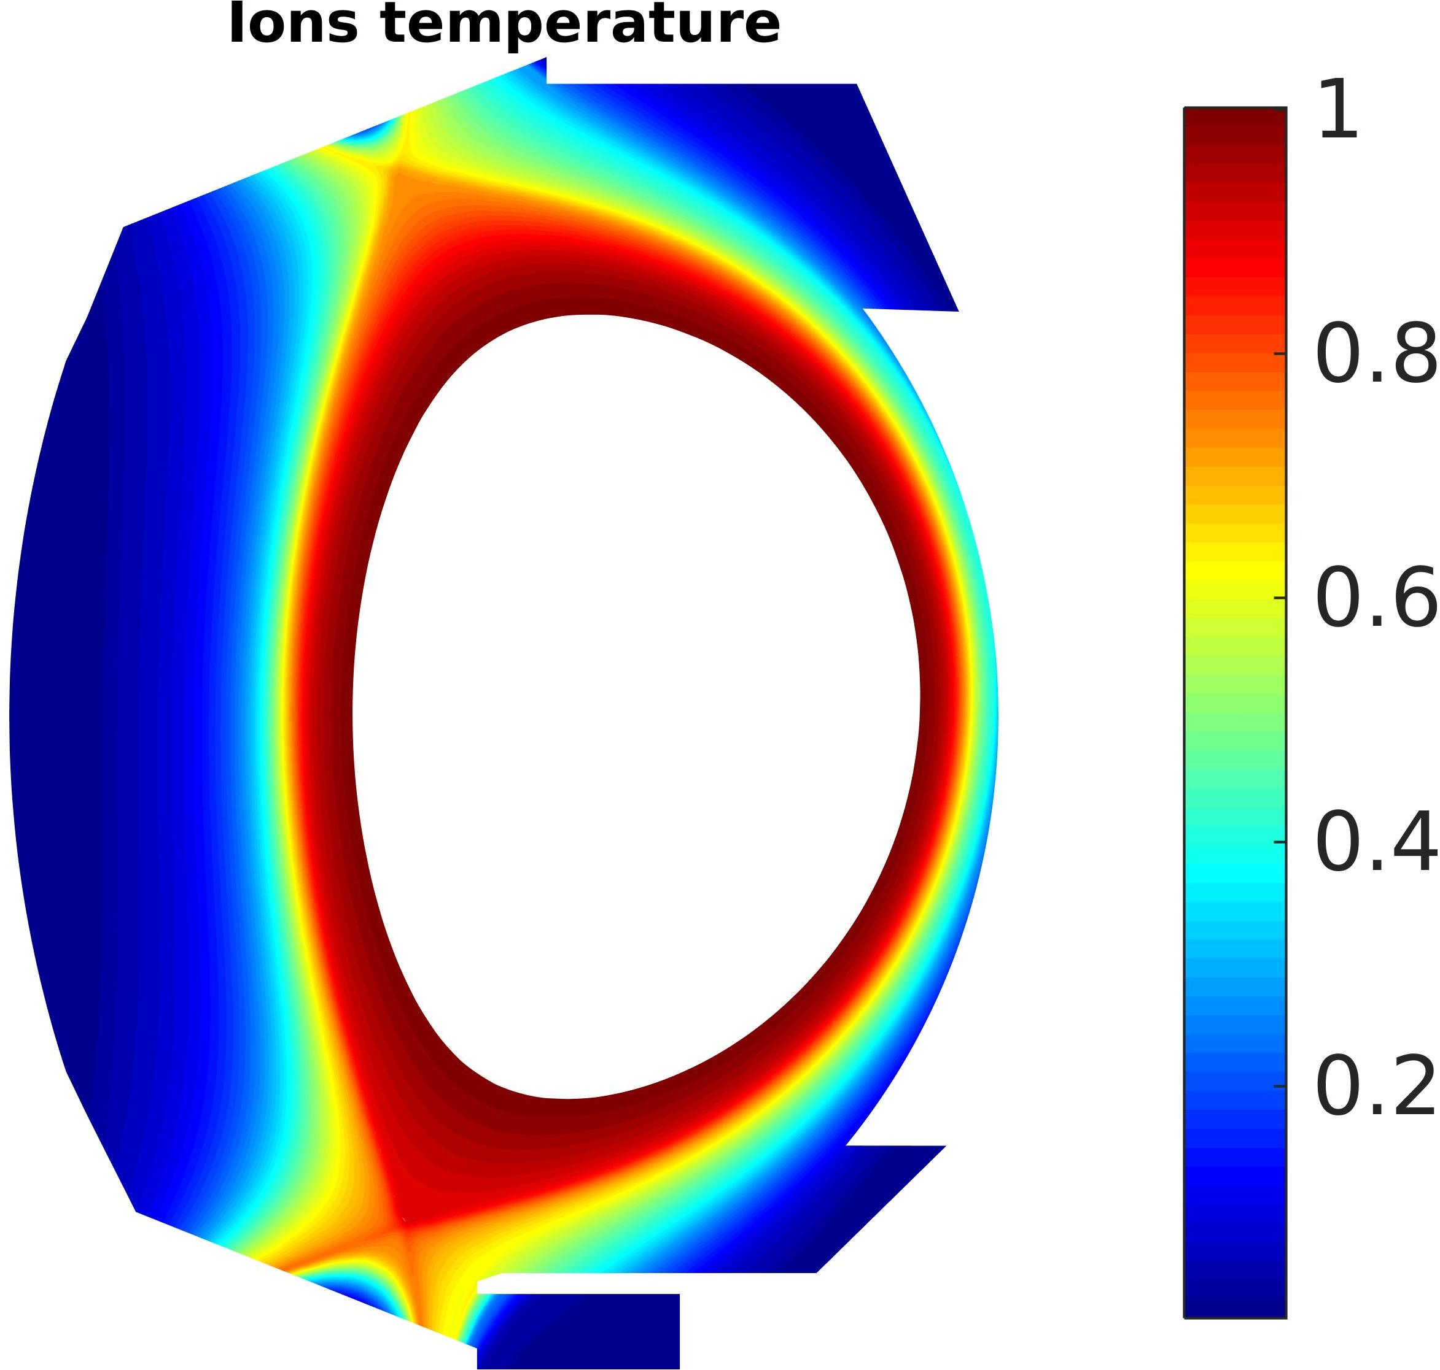
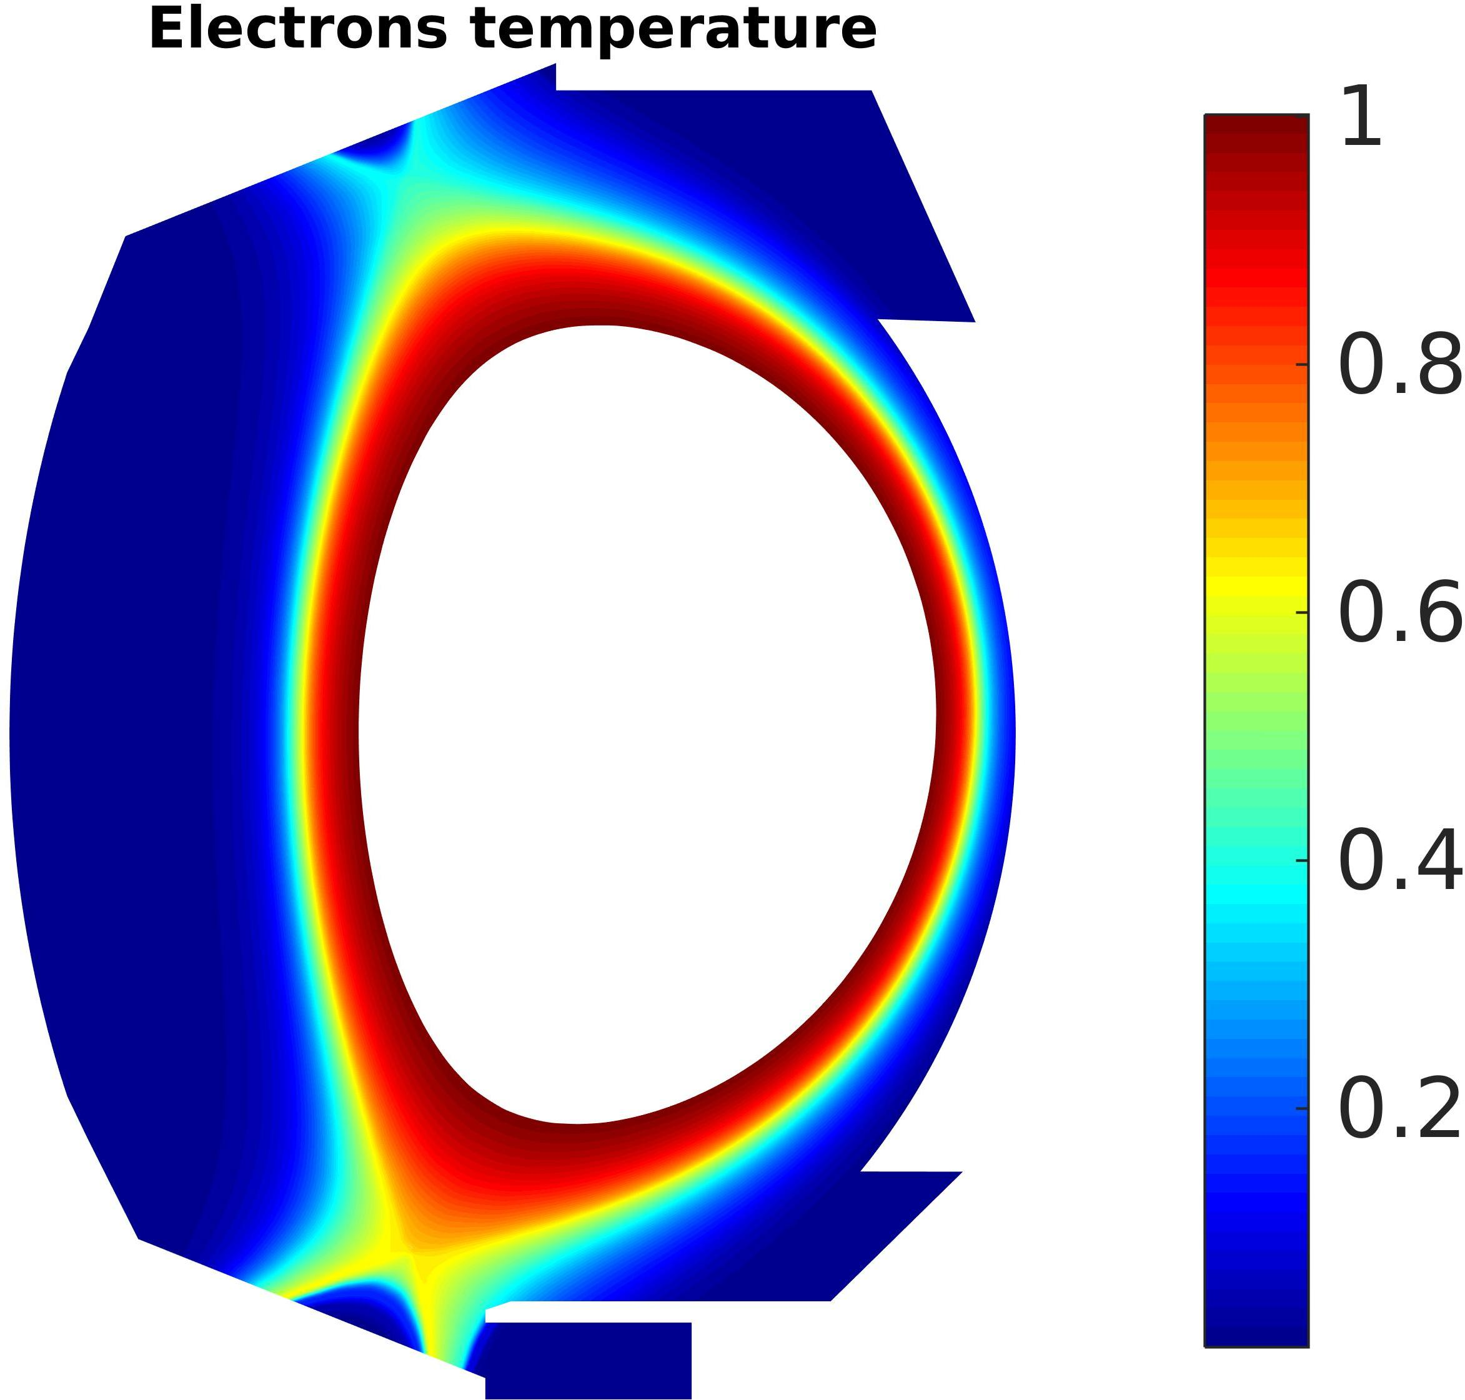
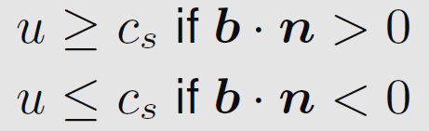
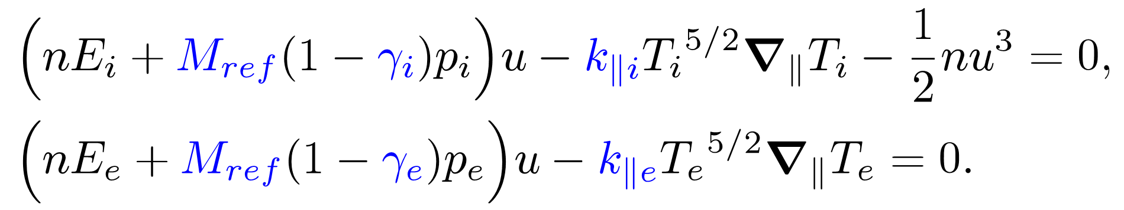

Numerical test: energy transport
Unknowns
$$n, u, E_{i}, E_{e}$$
Bohm boundary conditions
18/09/2018
Giorgiani et al. , Nuclear Materials & Energy, submitted
Notes:
Then I have extended the code to a non-isothermal model, so here I am showing the complete system with unknowns density, velocity, ions and electron energies. As you can see this is a much more complex system with of strong non-linearities. Also in this case we obtain very good results that allowed us to write a paper. Here you can see as an example the ions and electrons temperature in the tokamak WEST for a typical set of physical parameters.

Slide 20
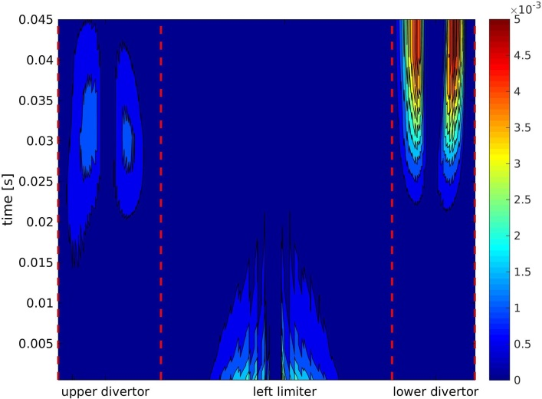
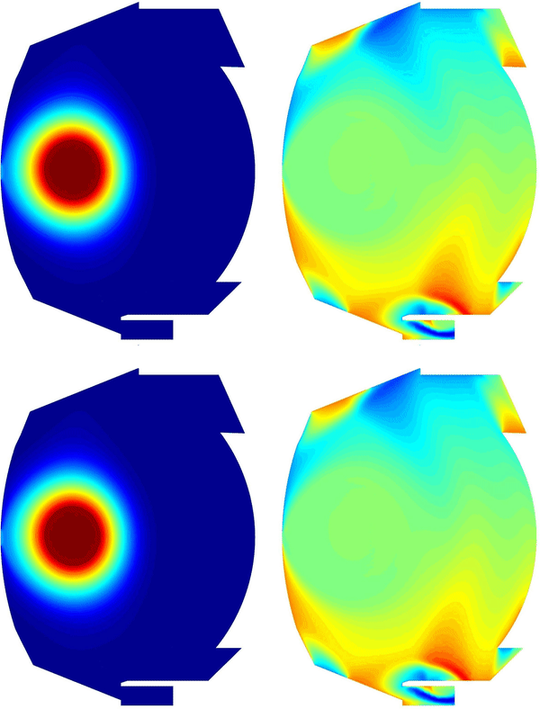

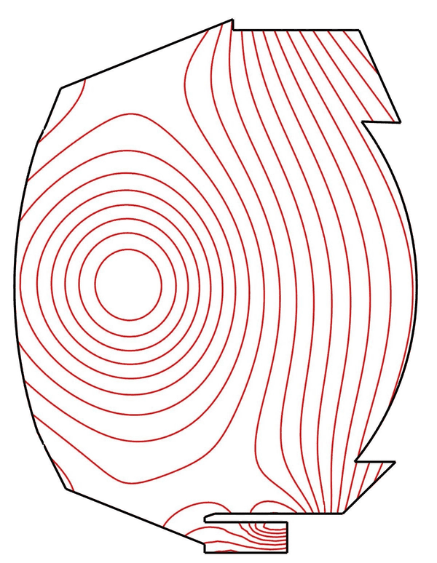
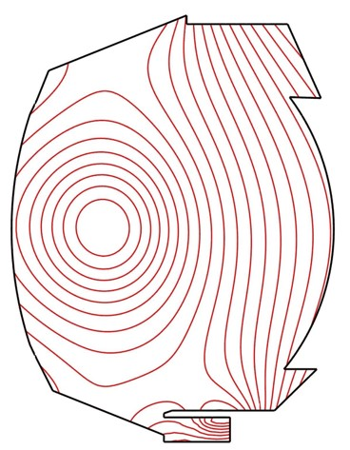

Numerical test: moving equilibrium simulations
Plasma response to different transition speeds
Heat load at walls
Non-aligned discretization
The mesh is independent of the magnetic field
No re-meshing in case of variable magnetic field
Left limiter
Time[s]
Work in collaboration with INRIA Sophia-Antipolis
Holger Heumann
Hervé Guillard
Boniface Nkonga
45ms
Upper divertor
Lower divertor
Magnetic transition limiter-divertor computed with the code FEEQS.M (Holger Heumann)
Time[s]
Left limiter
4.5ms
Upper divertor
Lower divertor
Giorgiani et al. , Contribution to Plasma Physics, 2018
Notes:
Finally, we also used the new solver to perform computations with variable magnetic fields. In fact, the non-aligned discretization allows us to avoid remeshing during the simulation. This is a collaboration with the INRIA Sophia-Antipolis. We have computed for example the transition from limiter configuration to the divertor configuration for the tokamak WEST. Here I will show you a movie where you can see the iso-lines of the magnetic flux, and here is the response of the plasma to different transition speeds. Finally we can also study the heat loads at the walls during the transition. We also wrote a paper about this work.

Slide 21
Conclusion and future work
Conclusions
A novel high-order scheme based on a HDG method is proposed on unstructured non-aligned meshes for simulating plasma transport in tokamaks.
High-order computation reveals to be effective in reducing the numerical diffusion introduced by the strongly anisotropic equations and the non-alignment.
Future work
Closed coupling equilibrium-transport: introduce a feedback from the plasma solution to the equilibrium computation.
Neutrals: introduce the neutrals equations in the system (PhD thesis of Matteo Valentinuzzi, IRFM).
Extension to 3D to perform turbulence simulations.
Notes:
To conclude the talk, we proposed a new high-order scheme based on a HDG method on non-aligned unstructured meshes for simulating the plasma transport in tokamaks.
High-order computations reveals to be effective in reducing the numerical diffusion introduced by the strong anisotropy of the plasma equations and the non aligned grids.
For the future work, we would like to introduce a feedback from the plasma solution to the equilibrium computations, to perform self-consistent computations equilibrium and transport.
We would like to introduce the neutrals in the system, there is a phd thesis at irfm dedicated to this subject. And finally I am working on the development of the 3d version of the code to perform turbulence simulations.

Slide 22
A high-order non-aligned approach for plasma transport simulations in tokamaks
Giorgio Giorgiani
Hugo Bufferand, Guido Ciraolo, Frederick Schwander, Philippe Ghendrih, Eric Serre, Patrick Tamain
Méthodes numériques pour les plasmas – Marseille, 23 novembre 2018

Slide 23




The numerical scheme: hybrid discontinuous Galerkin (HDG)
Rewrite as a system of first order equations
A quick overview of the scheme: Laplace equation
+ BC
+ BC
Equivalent problem in the broken domain
Triangulation of the domain
+
Broken domain
Notes:
We rewrite the problem as a system of first order equations, like that, introducing a new variable q which is the gradient of the primal unknown u. Then we introduce a triangulation of the domain, so the new broken domain is defined as the union of all the elements Omega_i, and epsilon is the skeleton of this triangulation, that is, the union of all the faces of the mesh. The equivalent Laplace problem in the broken domain is this one, where we have the original equations in each element and then we set to zero the jumps of the unknown u and the perpendicular component of the gradient of u across all the mesh interfaces.

Slide 24





The numerical scheme: hybrid discontinuous Galerkin (HDG)
Multiplication by test functions and integration in each element
Integral in the element volume
Integral in the element border
Weak form in each element
$$ω$$
$$·W$$
numerical traces:
defined on the edges of the mesh
allow to establish continuity in weak form between the elements
Typically in “classic” DG schemes (LDG,CDG,IP..)
HDG choice of the numerical traces:
Declare as a new unknown of the problem and set
substitute
Notes:
At this point we just write the weak form of the problem in each element, multiplying the two equation by test functions and integrating in each element. These terms with the hat are the unknowns of the problem on the border of the elements, and are called numerical traces. Those terms are fundamental in a DG schemes because they are the ones that allow us to impose the continuity between each element in a weak form. The choice of the numerical traces define completely the DG scheme that we are developing, and are crucial for the accuracy and stability of the method. Typically, in classic DG schemes, the numerical traces are defined as a combination of the values of the unknowns in the two elements that share the face where the trace is defined. However, in HDG we do something a bit different. We declare \hat(u) as a new unknown of the problem, and we set the trace for q in this way, where this coefficient tau is called stabilization parameter. So, substitute this relation in the weak form….

Slide 25











The numerical scheme: hybrid discontinuous Galerkin (HDG)
Weak form in each element
LOCAL PROBLEM
Solve for and as a function of
+
is single valued
Nodal values
Use this last relation to set up a global problem involving only
Global linear system
GLOBAL PROBLEM
Notes:
So we obtain this weak form in each element which correspond to this problem, that is, the original Laplace equation with this Dirichlet boundary condition, in each element. So this problem is well defined and solvable, and allow us to solve for the unknowns u and q as a function of \hat(u) in each element. Notice also that, since \hat(u) is single valued in each face of the mesh, this jump condition is automatically verified. Finally, we only need to impose the last relation, this one, that enforce the continuity of the fluxes over the interfaces, to set up a global system involving only the nodal values of the unknown \hat(u). In this figure I am showing for a single element mesh the nodes where the unknown \hat(u) is defined and the nodes where u and q are defined. It is clear that the hybridization technique allow us to reduce the size of the linear system, in particular for high-order elements.

